Slide 1



Student Performance Indicator
Presenter’s Name
Vishal Chouhan
Raj Lodhi
Devendra Singh Pipawad

Slide 2
Agenda
Introduction
Data
Using
Technologies
UI
Conclusion

Slide 3

Introduction
In this project, the performance of the students will be predicted so that their performance can be easily ascertained. And they will also know the reasons due to which their performance is decreasing. Performance indicators reflect what concrete tasks the student should be able to perform as a result of participation in the program.
This project are based on data science.
3

Slide 4


DATA
Data is separate pieces of information, like numbers, words, symbols, images, video etc.
This information can be used to understand something or make decisions.

Slide 5
Data Set
There are variables:
Gender: Sex of a student. (Male/Female)
Race/Ethnicity: Ethnicity of a student.
Parental level of education: parents' final education. (bachelor's degree, some college, master's degree, associate's degree, high school)
Lunch: What type of lunch the student had before test.
Test preparation course: Whether the student completed any preparation course before the test.
Reading score: Reading score obtained by the student.
Writing score: Writing score obtained by the student.
5

Slide 6
Target variable
Math score: Math score of a student..

Slide 7
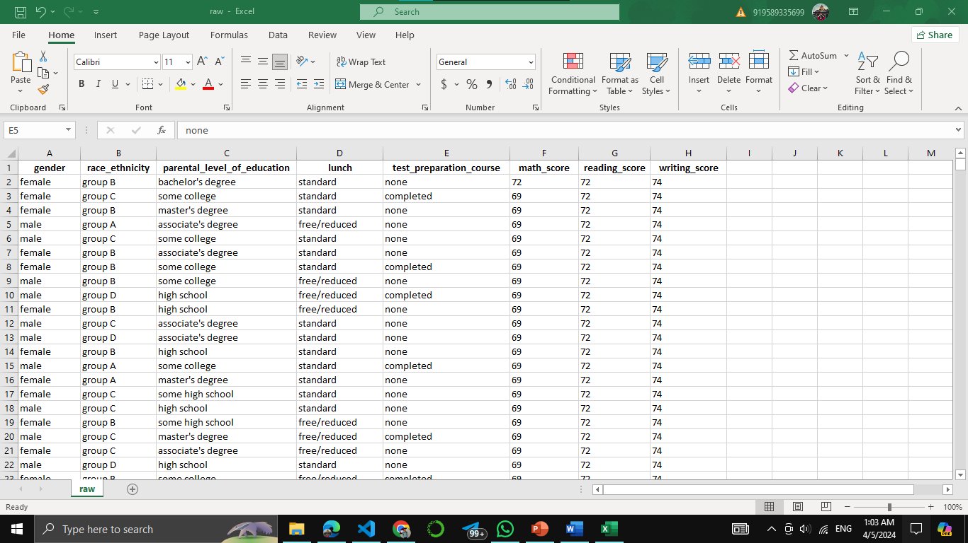

Slide 8



Using Technologies
machine learning
Other python libraries
8

Slide 9
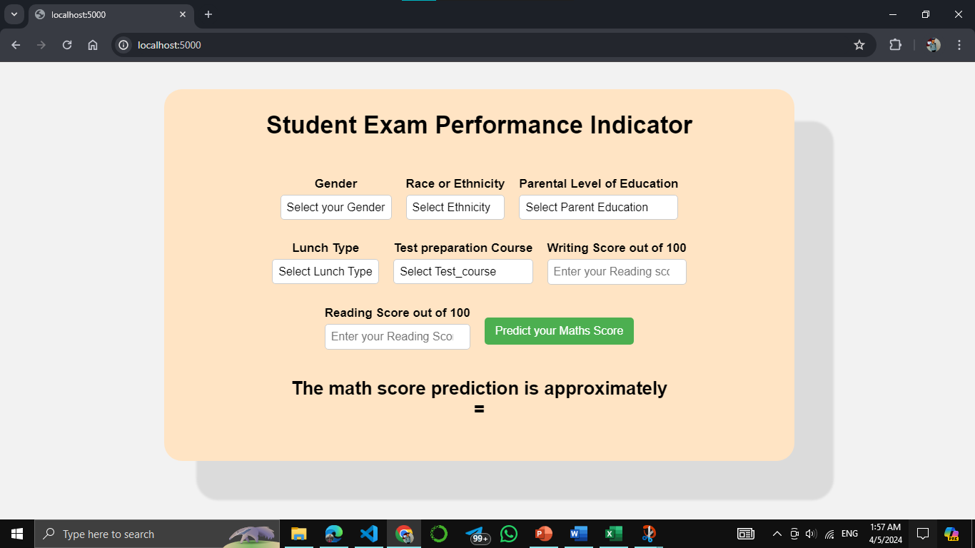
User Interface

Slide 10

Summary
The proposed system offers a promising solution to the challenges of tracking and analyzing student performance data. By leveraging Python programming language and machine learning techniques, the system provides a comprehensive platform for data collection, analysis, and visualization, enabling educators to make informed decisions that enhance student learning outcomes
10

Slide 11




Thank you

